Slide 1
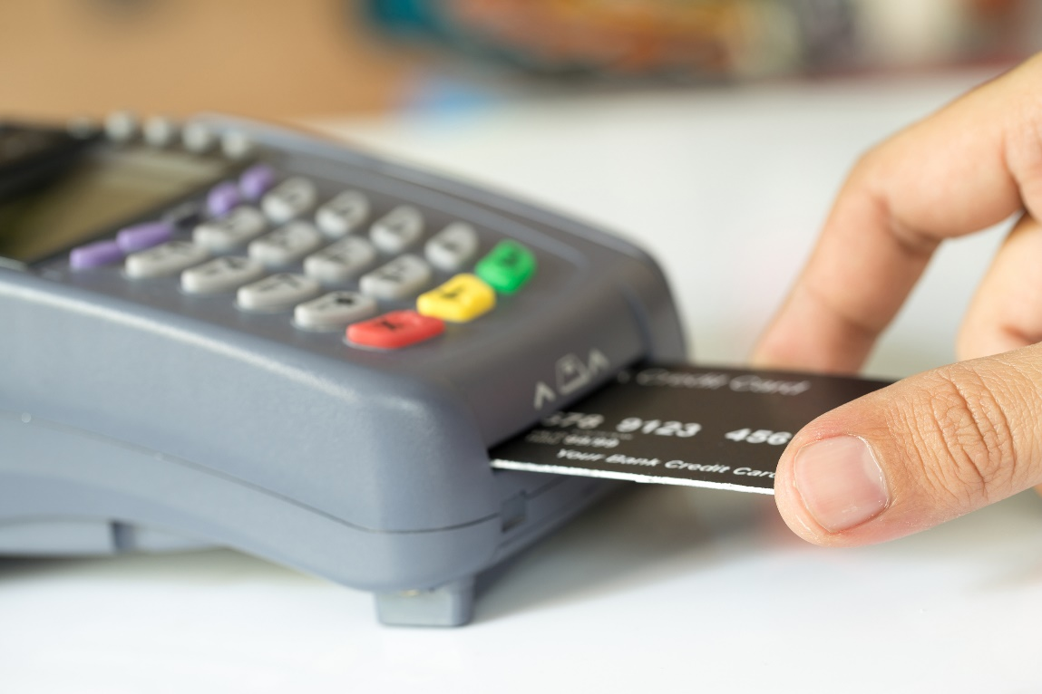
Transactions
Commit/Rollback
Auto Commit
Deadlocks
In JDBC

Slide 2

See Also
http://stackoverflow.com/questions/974596/what-is-a-database-transaction
http://www.tutorialspoint.com/jdbc/commit-rollback.htm
Notes:
Some additional information on concurrency

Slide 3
Transactions
Group SQL commands together
Atomic operation
Call “commit” if everything is OK
Call “rollback” to abort all changes
Locking
Deadlocks
Streams of bytes … two ways (into your program and out of your program)
Disks, consoles, sockets, keyboards, printers
Know how to talk streams and you can talk to anything
Initialization (constructor) is different. Use is the same.

Slide 4
Simplified BOOKS
connect 'jdbc:derby://localhost/books;create=true';
create table app.publishers(name varchar(20), phone int);
insert into app.publishers values ('Good Books',1234);
insert into app.publishers values ('Techin',4444);
select * from app.publishers;
create table app.books(name varchar(20),stock int, sold int);
insert into app.books values ('Java',10,0);
insert into app.books values ('C++',10,0);
select * from app.books;
PUBLISHERS
BOOKS
NAME | PHONE
Good Books | 1234
Techin | 4444
NAME | STOCK | SOLD
Java | 10 | 0
C++ | 10 | 0
Streams of bytes … two ways (into your program and out of your program)
Disks, consoles, sockets, keyboards, printers
Know how to talk streams and you can talk to anything
Initialization (constructor) is different. Use is the same.

Slide 5
Commit and Rollback
autocommit off;
update app.books set stock=9 where name='Java';
update app.books set sold=1 where name='Java';
rollback;
commit;
BOOKS
NAME | STOCK | SOLD
Java | 10 | 0
C++ | 10 | 0
BOOKS
NAME | STOCK | SOLD
Java | 9 | 1
C++ | 10 | 0
Streams of bytes … two ways (into your program and out of your program)
Disks, consoles, sockets, keyboards, printers
Know how to talk streams and you can talk to anything
Initialization (constructor) is different. Use is the same.

Slide 6
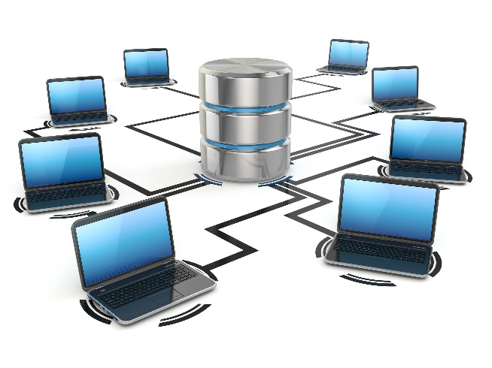
Locking (Row or Table)
autocommit off;
update app.books set stock=9 where name='Java';
commit;
autocommit off;
select * from app.books;
ERROR 40XL1: A lock could not be obtained within the time requested
Streams of bytes … two ways (into your program and out of your program)
Disks, consoles, sockets, keyboards, printers
Know how to talk streams and you can talk to anything
Initialization (constructor) is different. Use is the same.

Slide 7
Deadlocks
autocommit off;
update app.books set stock=9 where name='Java';
select * from app.publishers;
ERROR 40001: A lock could not be obtained due to a deadlock,
cycle of locks and waiters is:
Lock : ROW, PUBLISHERS, (1,9)
Waiting XID : {202, S} , APP, select * from app.publishers
Granted XID : {204, X}
Lock : ROW, BOOKS, (1,9)
Waiting XID : {204, S} , APP, select * from app.books
Granted XID : {202, X}
. The selected victim is XID : 202.
autocommit off;
update app.publishers set phone=5309 where
name='Techin';
select * from app.books;
commit;
Streams of bytes … two ways (into your program and out of your program)
Disks, consoles, sockets, keyboards, printers
Know how to talk streams and you can talk to anything
Initialization (constructor) is different. Use is the same.

Slide 8

In JDBC (Happy Path)
String s1 = "update app.books set stock=stock-1 where name='Java'";
String s2 = "update app.books set sold=sold+1 where name='Java'";
Connection con = DriverManager.getConnection("jdbc:derby://localhost/books");
con.setAutoCommit(false);
PreparedStatement stmt = con.prepareStatement(s1);
stmt.executeUpdate();
stmt.close();
PreparedStatement stmt2 = con.prepareStatement(s2);
stmt2.executeUpdate();
stmt2.close();
con.commit();
con.close();
Streams of bytes … two ways (into your program and out of your program)
Disks, consoles, sockets, keyboards, printers
Know how to talk streams and you can talk to anything
Initialization (constructor) is different. Use is the same.

Slide 9

In JDBC (Unhappy Path)
try(Connection con = DriverManager.getConnection("jdbc:derby://localhost/books")) {
con.setAutoCommit(false);
boolean success=false;
try {
try (PreparedStatement stmt = con.prepareStatement(s1)) {
stmt.executeUpdate();
}
try (PreparedStatement stmt = con.prepareStatement(s2)) {
stmt.executeUpdate();
}
con.commit();
success = true;
} finally {
if(!success) {
con.rollback();
}
}
}
Streams of bytes … two ways (into your program and out of your program)
Disks, consoles, sockets, keyboards, printers
Know how to talk streams and you can talk to anything
Initialization (constructor) is different. Use is the same.

Slide 10
In JDBC (Unhappy Path)
try(Connection con = DriverManager.getConnection("jdbc:derby://localhost/books")) {
con.setAutoCommit(false);
boolean success=false;
try {
try (PreparedStatement stmt = con.prepareStatement(s1)) {
stmt.executeUpdate();
}
try (PreparedStatement stmt = con.prepareStatement(s2)) {
stmt.executeUpdate();
}
con.commit();
success = true;
} finally {
if(!success) {
con.rollback();
}
}
}
Streams of bytes … two ways (into your program and out of your program)
Disks, consoles, sockets, keyboards, printers
Know how to talk streams and you can talk to anything
Initialization (constructor) is different. Use is the same.

Slide 11
Transaction Layer
public class Tinker {
static {
try {
Class.forName("org.apache.derby.jdbc.ClientDriver");
} catch (ClassNotFoundException e) {
throw new RuntimeException(e);
}
}
public static Connection getConnection() throws SQLException {
return DriverManager.getConnection("jdbc:derby://localhost/books");
}
...
}
Streams of bytes … two ways (into your program and out of your program)
Disks, consoles, sockets, keyboards, printers
Know how to talk streams and you can talk to anything
Initialization (constructor) is different. Use is the same.

Slide 12
Transaction Layer
public static void sellBook(Connection conn, String name) throws SQLException {
String s1 = "update app.books set stock=stock-1 where name=?";
String s2 = "update app.books set sold=sold+1 where name=?";
try (PreparedStatement stmt = conn.prepareStatement(s1)) {
stmt.setString(1, name);
stmt.executeUpdate();
}
try (PreparedStatement stmt2 = conn.prepareStatement(s2)) {
stmt2.setString(1, name);
stmt2.executeUpdate();
}
}
Streams of bytes … two ways (into your program and out of your program)
Disks, consoles, sockets, keyboards, printers
Know how to talk streams and you can talk to anything
Initialization (constructor) is different. Use is the same.

Slide 13
Transaction Layer
public static int getSoldCount(Connection conn, String name) throws SQLException { ... }
public static int getStockCount(Connection conn, String name) throws SQLException { ... }
public static void setSoldCount(Connection conn, String name, int cnt) throws SQLException { ... }
public static void setStockCount(Connection conn, String name, int cnt) throws SQLException { ... }
public static void sellBook2(Connection conn, String name) throws SQLException {
int sold = getSoldCount(conn, name);
setSoldCount(conn, name, sold+1);
setStockCount(conn, name, getStockCount(name)-1);
}
Streams of bytes … two ways (into your program and out of your program)
Disks, consoles, sockets, keyboards, printers
Know how to talk streams and you can talk to anything
Initialization (constructor) is different. Use is the same.

Slide 14

Transaction Layer
public static void main(String[] args) throws SQLException {
try(Connection conn = getConnection()) {
conn.setAutoCommit(false);
boolean success=false;
try {
sellBook(conn,"Java");
// ...
conn.commit();
success = true;
} finally {
if(!success) {
conn.rollback();
}
}
}
}
Streams of bytes … two ways (into your program and out of your program)
Disks, consoles, sockets, keyboards, printers
Know how to talk streams and you can talk to anything
Initialization (constructor) is different. Use is the same.

Slide 15

Tinkering
Flesh out the methods in the “Transaction Layer” section of this lesson.
Put an infinite loop around the main() code and run the program in two separate command windows. Do the programs walk on each other?
Lock the BOOKS table with an update in IJ. Then run your program. How does your program behave?

